Slide 1
Weekly Updates
9/9-9/15
Overdevest Lab

Slide 2
HHT
Epistaxis and Genetics
Where are HHT patients enrolling from?
Barrier: how to define a “pathogenic” mutation
Barrier: low rate of pathogenic variants in HHT cohort?
Barrier: incomplete phenotype data
Next steps, and 2 potential paper angles

Slide 3
Epistaxis and Genetics
Genetics of people with epistaxis
  19,202 people with epistaxis
  68 (0.35%) have a qualifying P/LP variant
    39 ENG, 27 ACVRL1, 2 SMAD4, 0 GDF2
Epistaxis rates by genetic status
  Carrier epistaxis rate: 68/1085 = 6.27%
  Non-carrier epistaxis rate: 19,134/745,944 = 2.57%
  Odds ratio: 2.54, p<0.001

Slide 4
Where are our HHT patients enrolling from?
EHR Linkage to a Real Clinical Site, by Group
Study group | Participants | Linked to EHR site | Linked (%)
General population | 5,000 | 2,551 | 51.0%
Genetic mutation (no diagnosis) | 1,047 | 619 | 59.1%
HHT diagnosis | 260 | 240 | 92.3%
Some may have not submitted EHR to AoU
AoU assigns EHR data like visits a “src_id” which is unique to each institution - but you cannot trace it back to the institution name
Variables extracted: reported state of residence, and “primary clinical site” = site with the most visits
Comparing HHT patients to mutation-only patients, and a random sample of 5,000 controls:
Site Concentration Among Participants With a Linked EHR Site
Study group | Linked participants | Distinct sites | Top site | Top-site share | HHI
General population | 2,551 | 61 | EHR site 699 | 8.8% | 0.040
Genetic mutation (no diagnosis) | 619 | 51 | EHR site 321 | 12.3% | 0.044
HHT diagnosis | 240 | 30 | EHR site 392 | 15.4% | 0.076
Top Primary EHR Sites by Study Group
Study group | Primary EHR site | Participants | Share of linked
General population | EHR site 699 | 224 | 8.8%
 | EHR site 321 | 223 | 8.7%
 | EHR site 305 | 180 | 7.1%
 | EHR site 638 | 133 | 5.2%
 | EHR site 195 | 109 | 4.3%
Genetic mutation (no diagnosis) | EHR site 321 | 76 | 12.3%
 | EHR site 699 | 59 | 9.5%
 | EHR site 638 | 25 | 4.0%
 | EHR site 765 | 25 | 4.0%
 | EHR site 250 | 23 | 3.7%
 | EHR site 305 | 23 | 3.7%
HHT diagnosis | EHR site 392 | 37 | 15.4%
 | EHR site 305 | 31 | 12.9%
 | EHR site 638 | 22 | 9.2%
 | EHR site 321 | 19 | 7.9%
 | EHR site 699 | 17 | 7.1%

Slide 5
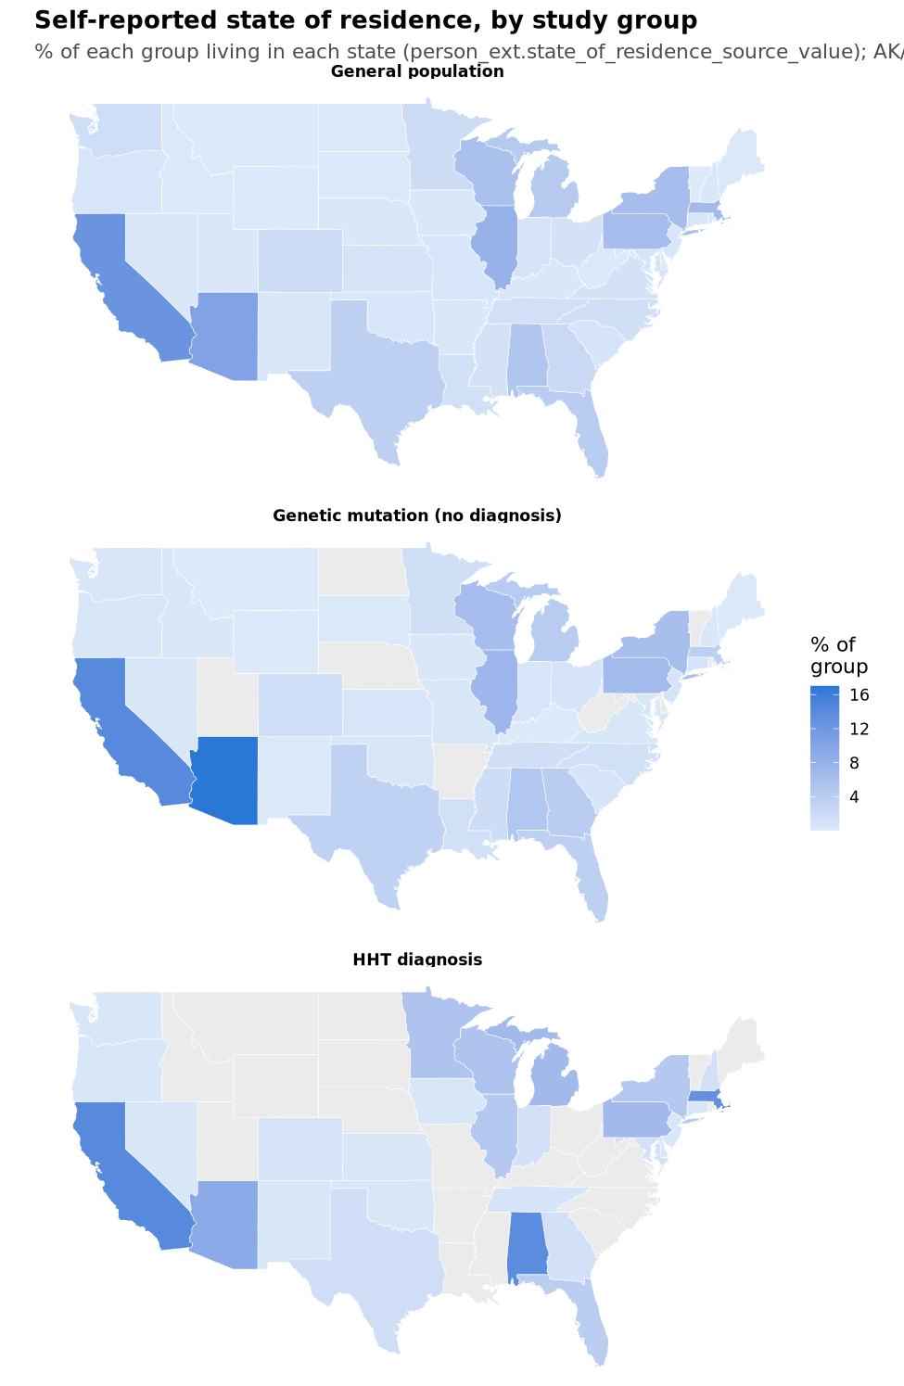
Top Self-Reported States by Study Group
Study group | State | Participants | Share of group
General population | CA | 630 | 12.6%
 | AZ | 516 | 10.3%
 | IL | 398 | 8.0%
 | MA | 333 | 6.7%
 | PA | 322 | 6.4%
Genetic mutation (no diagnosis) | AZ | 178 | 17.0%
 | CA | 149 | 14.2%
 | IL | 77 | 7.4%
 | PA | 71 | 6.8%
 | WI | 66 | 6.3%
HHT diagnosis | CA | 37 | 14.2%
 | AL | 36 | 13.8%
 | MA | 34 | 13.1%
 | AZ | 24 | 9.2%
 | MI | 18 | 6.9%
 | PA | 18 | 6.9%
Notes:
Shows value of centers of excellence (AL, MA)

Slide 6
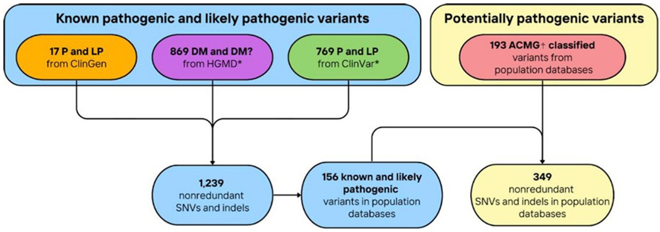
Barrier: what mutations are “pathogenic?”
Once variant data is extracted from AoU, how do we interpret it?
  2015 ACMG (American College of Medical Genetics) guidelines: General framework for interpreting variants for any disease
    gnomAD: how common is this variant in the general population?
  ClinVar: laboratories submit their classifications; strength of supporting evidence may vary
    Up until now this is what I have been using
  ClinGen: experts review evidence to classify variants according to the above 2015 general guidelines
  2024 HHT-specific ACMG/AMP guidelines
  HGMD (Human Gene Mutation Database): has scientific literature noted an association with disease?
Will reviewers want us to implement HHT-specific ACMG/AMP instead of relying on ClinVar?
From Gaetani et al 2026: Global prevalence of hereditary hemorrhagic telangiectasia-associated variants estimated by analysis of large-scale genomic databases
Notes:
Use ACMG/AMP for initial pull (most specific?), similar to Gaetani et al.
Maybe use HGMD as the gold standard.

Slide 7
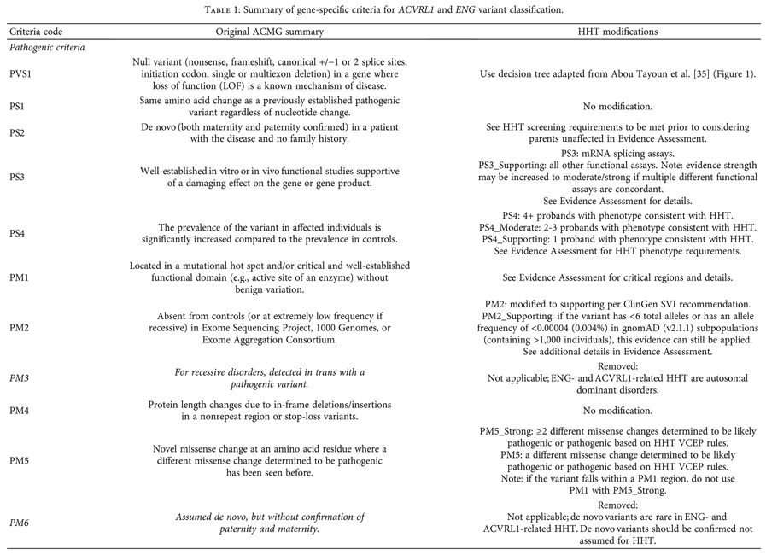
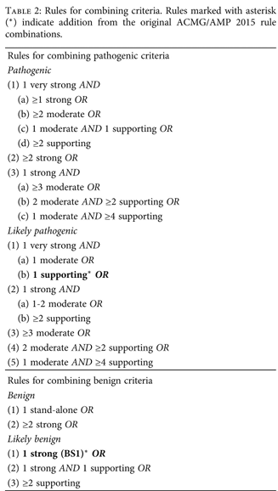
ACMG/AMP: a framework for classifying HHT genes

Slide 8
Barrier: HHT-diagnosed patients have a low rate of pathogenic variants?
Only 38 of 260 clinically diagnosed HHT patients have a P/LP (ClinVar) variant. 22 ACVRL1, 14 ENG, 2 SMAD4
Two explanations for why many HHT patients apparently have no mutation that may be both partially correct:
  People are being diagnosed clinically and yet they have no mutation = maybe they're being overdiagnosed?
  We are missing variants because this is just based on ClinVar which probably only captures ~60% of known pathogenic and likely pathogenic variants, and misses potentially pathogenic variants per ACMG

Slide 9
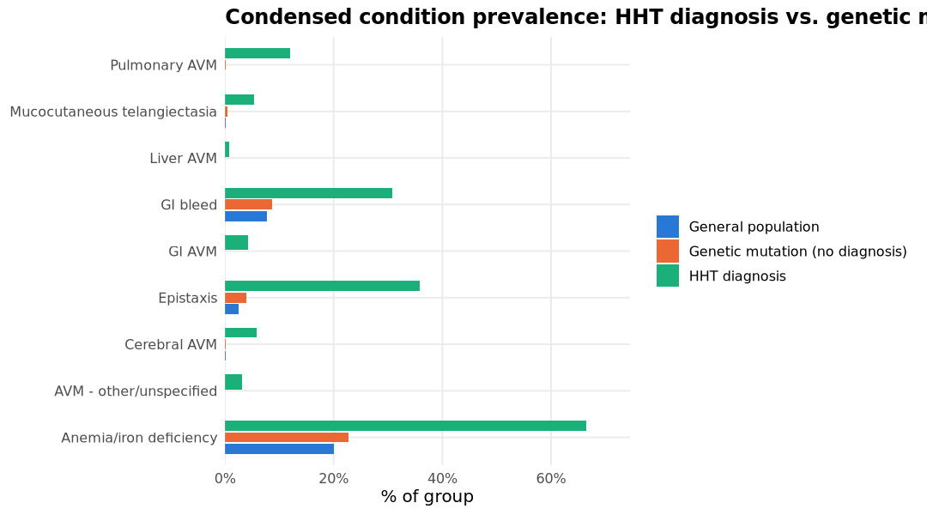
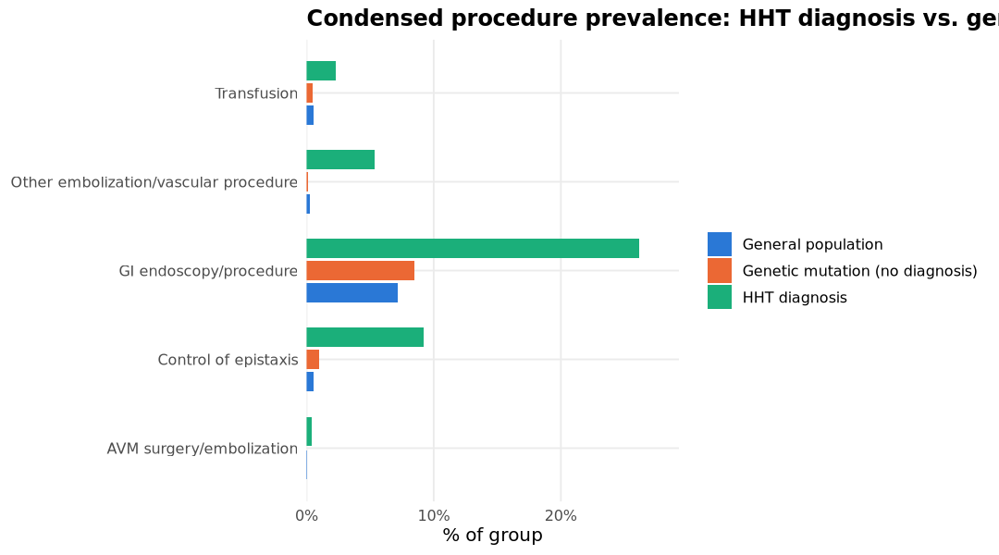
Barrier: likely incomplete capture of phenotype data

Slide 10
Next steps
Awaiting further comms with Dr. Christine Garcia’s team
  IRB protocol completed, approval pending
Potential angles for our first paper:
  “Clinical” paper: HHT is more common than 1 in 5,000 by clinical diagnosis alone
  “Genetic diagnosis” paper: a lot of people probably have HHT but haven’t been diagnosed

Slide 11
1. “Clinically” higher rates than expected
  One-liner: HHT is more common than 1 in 5,000 by clinical diagnosis alone
    260 out of 747,040 is ~ 1 in 2,873
    Figure: geographic prevalence (relative to AoU in general)
    Table: symptom rates
      What ages do people first bear symptom diagnoses?
      What age are they first diagnosed with HHT?
    Table: procedure rates
    Incidence rates
    Unclear role of genetic data? Leave it out
  Limitations:
    Unclear reliability of EHR data
      Are clinicians not documenting which Curacao criteria patients are meeting?
Notes:
Otolaryngology target journal (Laryngoscope) maybe brief communication, or AAO-HNS.

Slide 12
2. Genetic “Lost Generation” paper
One-liner: Are there patients walking around with genetic mutations, who might have epistaxis rates higher than the general population, who are going undiagnosed?
  Table: symptom rates of general population vs mutation patients vs clinically diagnosed patients
Advantage over Gaetani et al 2026: incorporating phenotype data (even though it may not be 100% sensitive)
  Key decision point: how granular/robust do we want our genetic analysis to be?

Slide 13
2. Genetic “Lost Generation” paper
Condition category | Study group | People | Group size | Rate
AVM - other/unspecified | General population | 155 | 745,722 | 0.02%
 | Genetic mutation (no diagnosis) | 0 | 1,047 | 0.00%
 | HHT diagnosis | 8 | 260 | 3.08%
Anemia/iron deficiency | General population | 149,827 | 745,722 | 20.09%
 | Genetic mutation (no diagnosis) | 238 | 1,047 | 22.73%
 | HHT diagnosis | 173 | 260 | 66.54%
Cerebral AVM | General population | 1,129 | 745,722 | 0.15%
 | Genetic mutation (no diagnosis) | 1 | 1,047 | 0.10%
 | HHT diagnosis | 15 | 260 | 5.77%
Epistaxis | General population | 19,068 | 745,722 | 2.56%
 | Genetic mutation (no diagnosis) | 41 | 1,047 | 3.92%
 | HHT diagnosis | 93 | 260 | 35.77%
GI AVM | General population | 235 | 745,722 | 0.03%
 | Genetic mutation (no diagnosis) | 0 | 1,047 | 0.00%
 | HHT diagnosis | 11 | 260 | 4.23%
GI bleed | General population | 57,633 | 745,722 | 7.73%
 | Genetic mutation (no diagnosis) | 91 | 1,047 | 8.69%
 | HHT diagnosis | 80 | 260 | 30.77%
Liver AVM | General population | 5 | 745,722 | 0.00%
 | Genetic mutation (no diagnosis) | 0 | 1,047 | 0.00%
 | HHT diagnosis | 2 | 260 | 0.77%
Mucocutaneous telangiectasia | General population | 774 | 745,722 | 0.10%
 | Genetic mutation (no diagnosis) | 5 | 1,047 | 0.48%
 | HHT diagnosis | 14 | 260 | 5.38%
Pulmonary AVM | General population | 112 | 745,722 | 0.02%
 | Genetic mutation (no diagnosis) | 1 | 1,047 | 0.10%
 | HHT diagnosis | 31 | 260 | 11.92%
Notes:
Get the overlap HHT+genetics

Slide 14
ABCD

Slide 15
Next steps
Reached out to Heaven, will be coming in person to clinic days starting 9/21

Slide 16
Dr Eckert projects

Slide 17
Next steps
Meeting tomorrow to discuss:
  Collaboration with Dr. Schlosser at MUSC regarding imaging dataset with olfaction and taste measures
  Olfactometer/MATLAB
  +/- temporal expectation fMRI, polygenic risk scores

